Slide 1
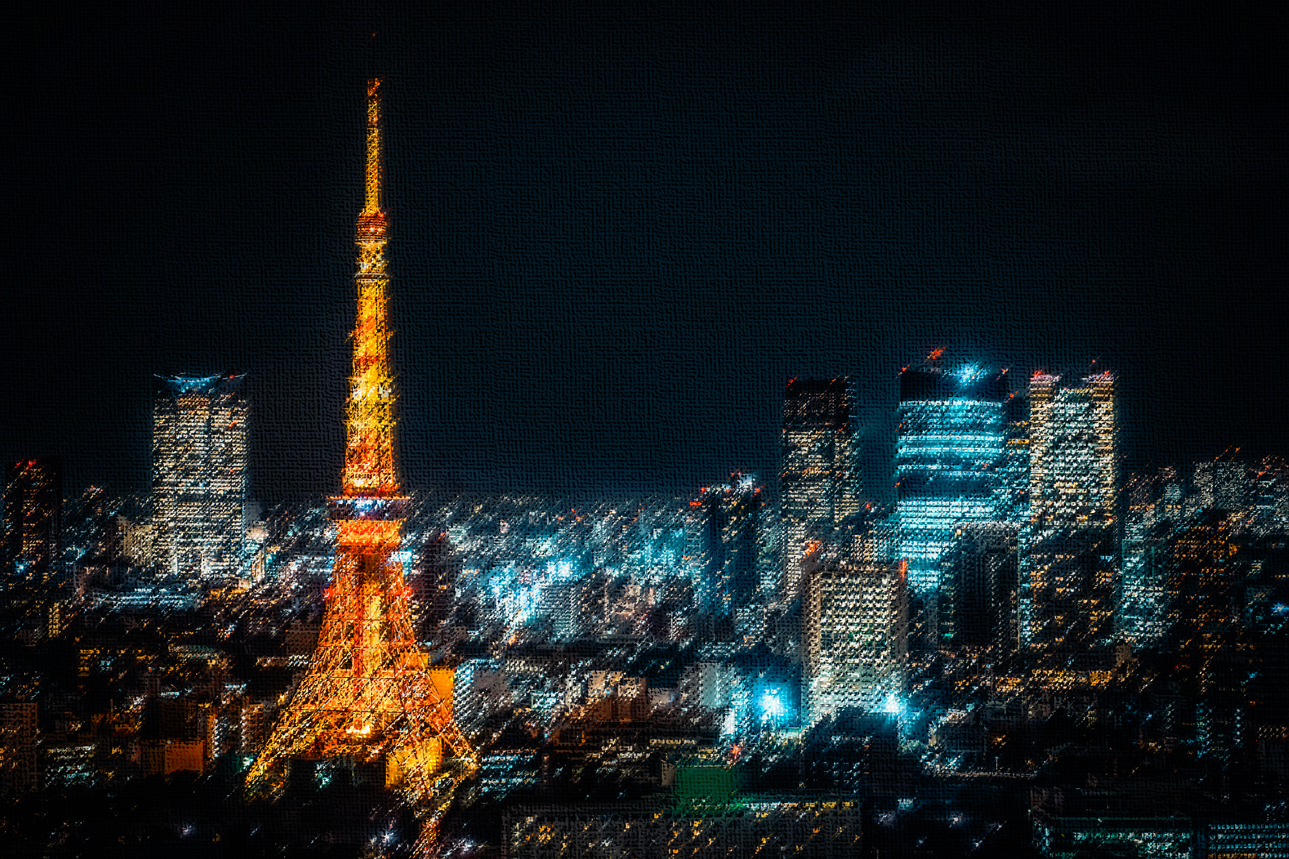
Self-Introduction & Summer Plan
C.A. O’Hara | NEC | August 2023

Slide 2
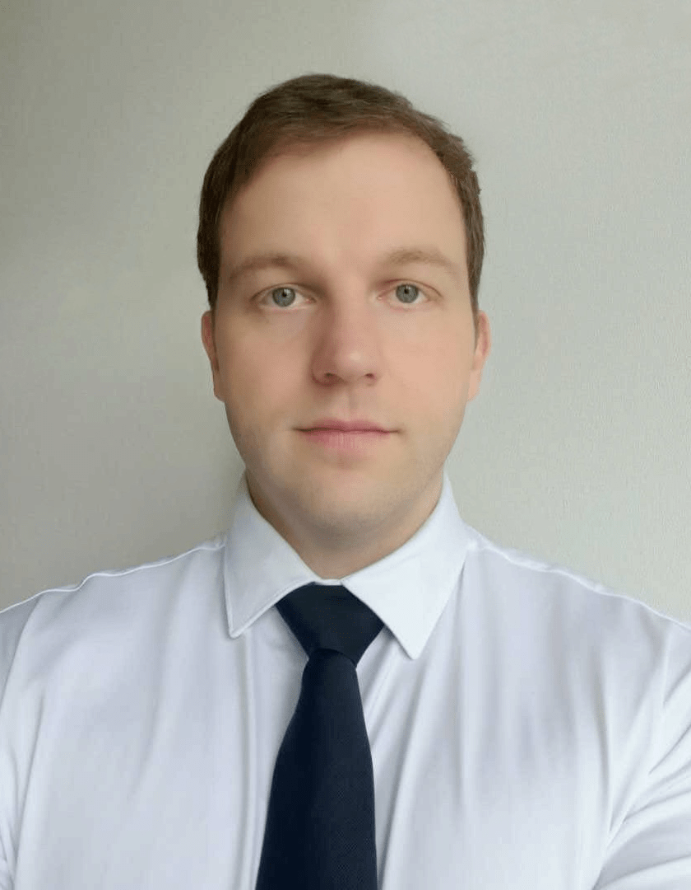
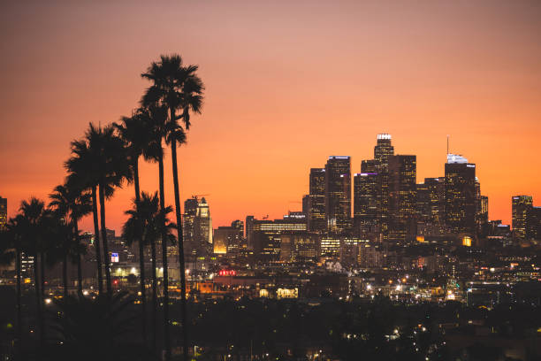
Christopher O’Hara
PhD/DEng Candidate (D2)
Department of Aeronautics and Astronautics, Graduate School of Engineering, University of Tokyo
DEng: Aeronautics & Astronautics (JP, 2021-2024)
EngD: Software Technology (NL, 2021)
MEng: Biomedical Engineering (USA, 2021)
MSc: Mechatronics (USA, 2020)
MSc: Embedded Systems (NL, 2019)
MSc: Autonomous Systems (DE, 2018)
BA: Science, Technology, & Society (USA, 2015)

Slide 3
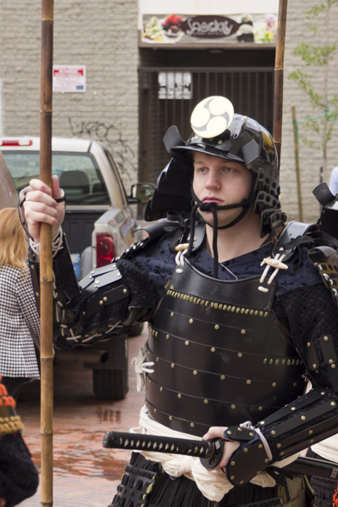
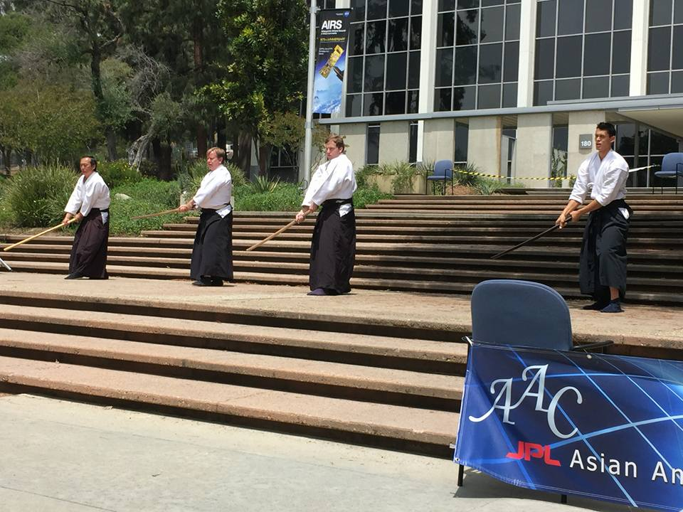
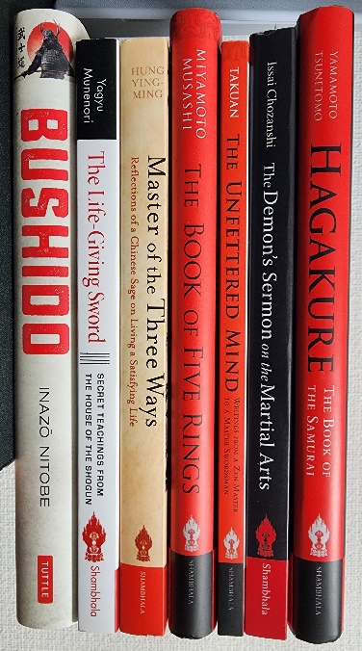
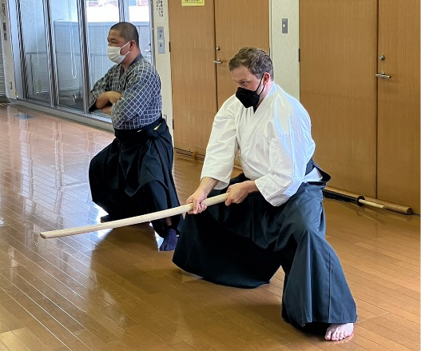
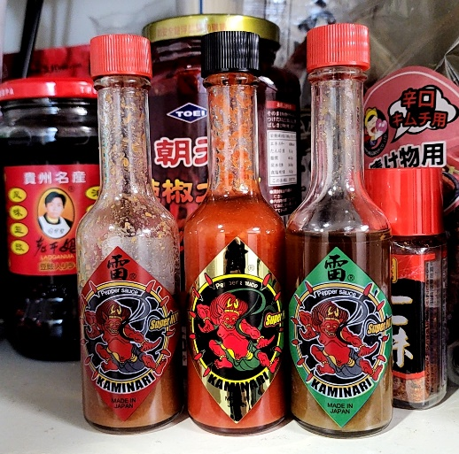
Work Background:
NASA Ames, Software System Engineer (USA, 2022)
Siemens, System Design Architect (BE, 2021)
ESA, Lead AI System/Software Architect (NL, 2020)
CERN, Project Manager/Product Owner (CH, 2019)
Career goal: AI System Architect

Slide 4
Problem Statement
効率的なタスク完了のための移動ロボットプラットフォームにおけるセンサーフュージョンの探求。
従来の手法では、利用可能なセンサーを十分に活用しないか、すべてのセンサーを常にアクティブな状態に保ち、非効率的なエネルギー消費につながる。
適応的センサー・フュージョン、パス・プランニングのようなタスクに特化した要求に対して、位置、方向認識を最適化する。
目標：ロボットの現在のタスクと環境条件に基づいてセンサの起動を動的に切り替える、エージェントベースのコンテキスト認識システムを開発する。

Slide 5
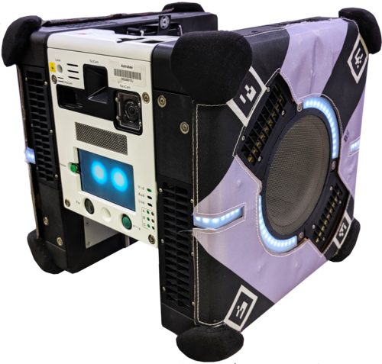
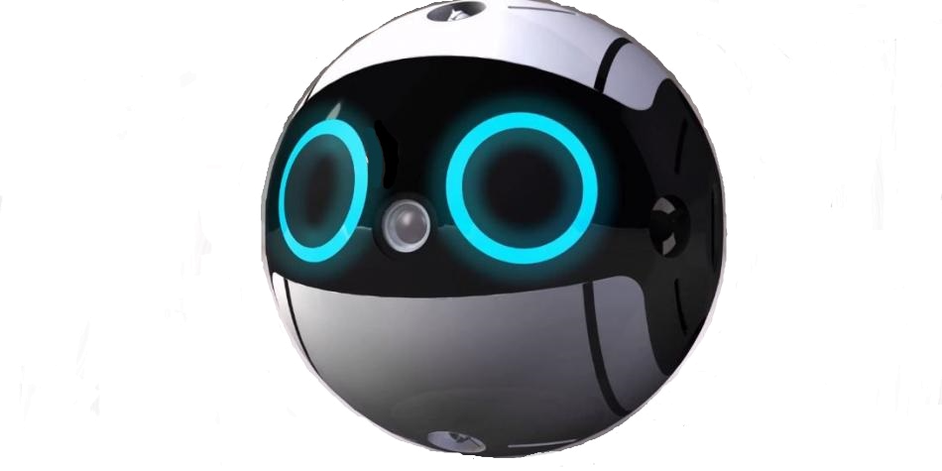
Personal Satellite Assistants (PSA)
NASA: Astrobee
JAXA: JEM (INT-Ball)

Slide 6
Questions
How can we vary sensor combinations to meet the task requirements?
Toggle sensors inputs, switch sensor fusion methods
Can an agent self-determine which sensors/fusion algorithms to use?
Agent decision-making (goal-oriented); “increase confidence”
Can a robot make resilient decisions based on policies and adaptive sensor information?
Policy: Minimize energy, heat, task time
Task: Navigation to goal, SLAM, “take picture”
Toggle/integrate sensors if not “confident” in state

Slide 7
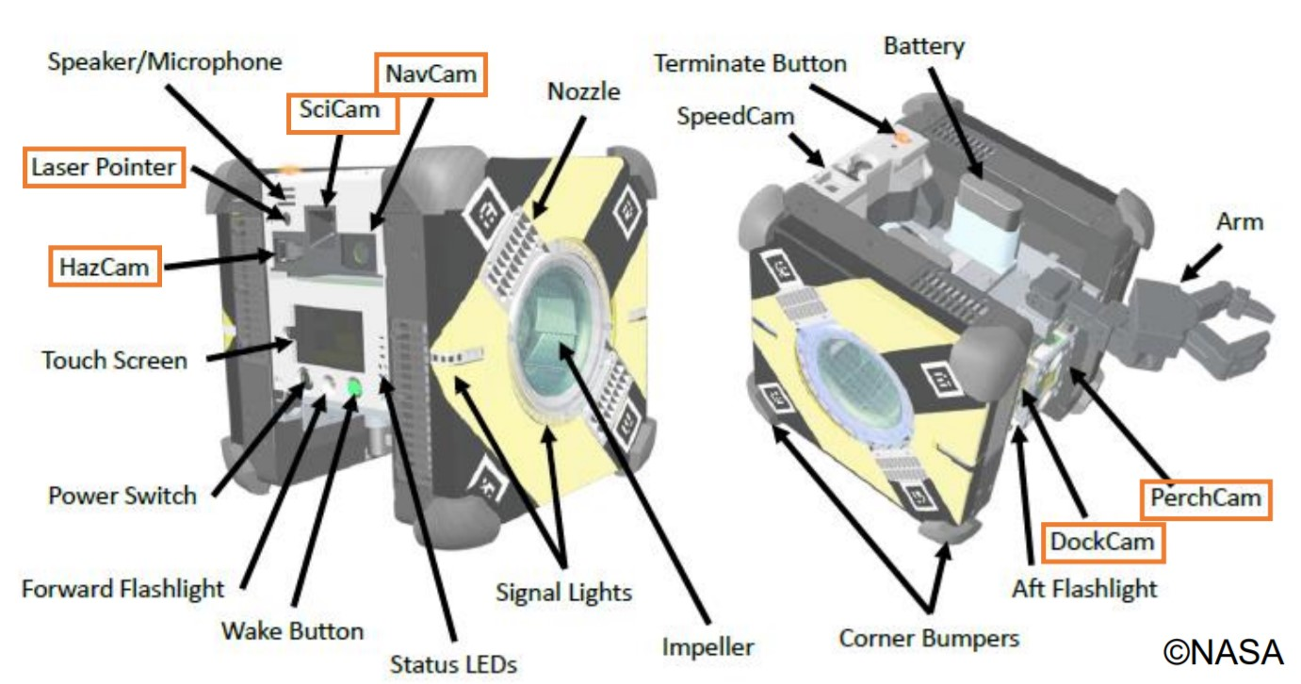
Astrobee Sensors Data

Slide 8
General Challenges
Sensor data can vary vastly
Visual information (images, video) vs Time-series (signals)
Discrete values (points) versus Continuous (signals)
Noisy, missing values, anomalies
Sensors can be time-driven or event-driven
Time-driven sensors have different sampling rates
Event-driven sensors only trigger upon event
↑ No. Sensors ⇒ ↑ Energy ⇒ ↑ Heat
↑ Energy consumption ⇒ ↓ Operation Time
Assumption: ↑ No. Sensors ⇒ ↑ Information

Slide 9
Chaotic/Dynamical System (Space Station)
Microgravity
Objects continually gravitate towards the walls [NASA/TM—2002-211693]
Depends on mass distribution inside (and outside) the ISS
Movements of astronauts (EVA), docking, depressurization
Can induce “invisible” drift on vehicle model
Airflow
Ventilation system is always on [NASA/SSP 51721]
Flows are stronger near walls and doorways
Objects also draw airflow due to no convection
Onboard propulsion/fans influence drift/jerk
Heat
Confounding with airflow (not too influential [Ivanov 2021])
Heat creates additional sensor noise (thermal noise)
Other:
Fans, pumps, exercise equipment, latches, hinges, vents [NASA/TM-211693]

Slide 10
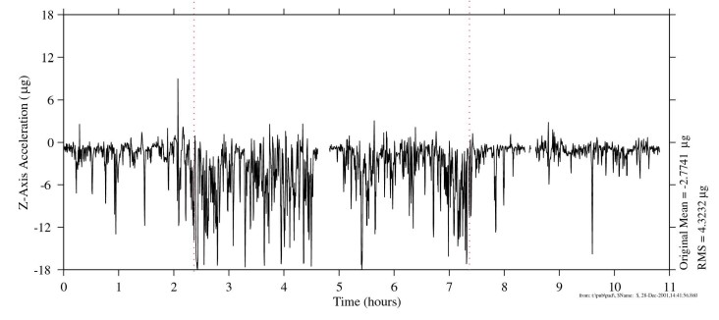
Microgravity during EVA
EVA
[NASA/TM—2002-211693]

Slide 11
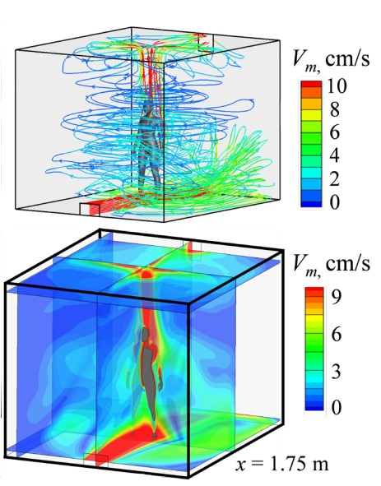
Flow/Heat
[Ivanov 2021]

Slide 12
General Approach
Replicate Astrobee conditions and simulation environment
Start with NavCam + IMU, and EKF
Add in other available sensors (published)
Extend simulation environment
Implement other sensor fusion algorithms
Kalman Filters, Neural Networks, Bayesian Networks, Gaussian Processes
Add other sensors (not on Astrobee or not published)
ToF, Laser Scanners, Cameras, Sonar
Evaluate in chaotic simulation environment
Synthetic data generation (light, angle, placement, noise, wind)
Task completion confidence
Allow agent to determine which sensors/fusion to use based on the context (policy, rules, priorities, risk)
Test, benchmark, verify, validate

Slide 13
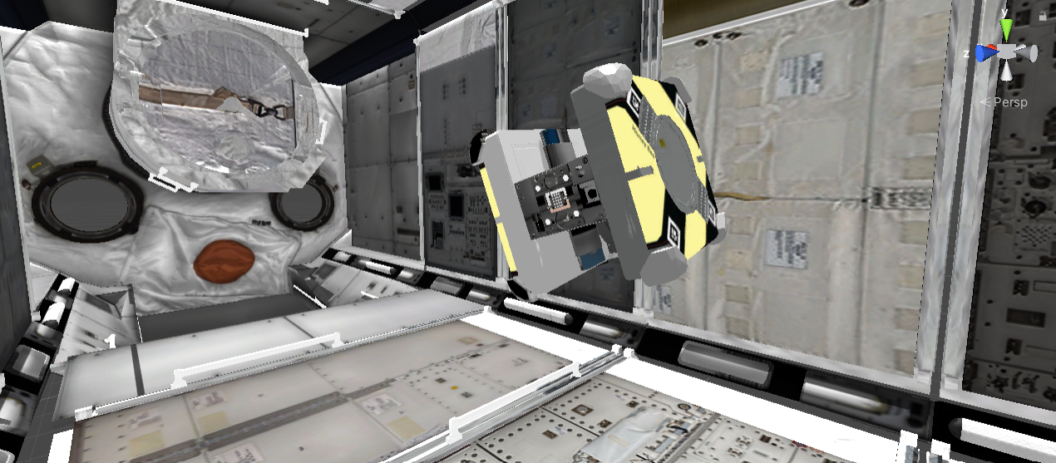
Simulation Environment (Unity/ROS)

Slide 14
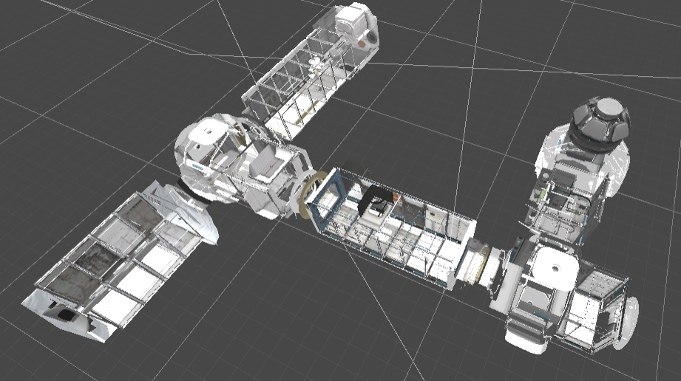

Slide 15
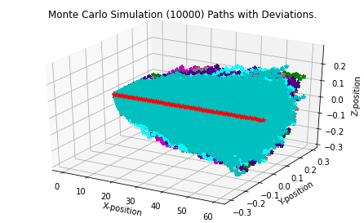
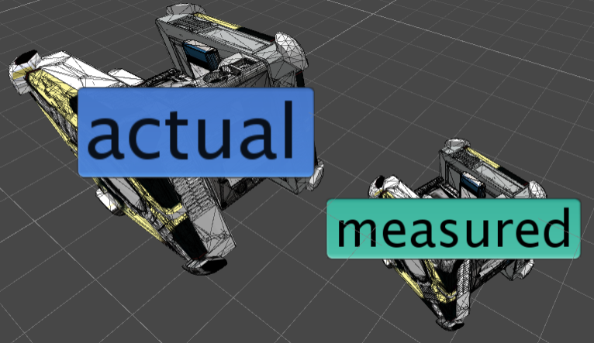
Microgravity Simulation (Monte Carlo)
Features: drag, inertia, noise (Gaussian with “tendency”), probabilistic pull of microgravity

Slide 16
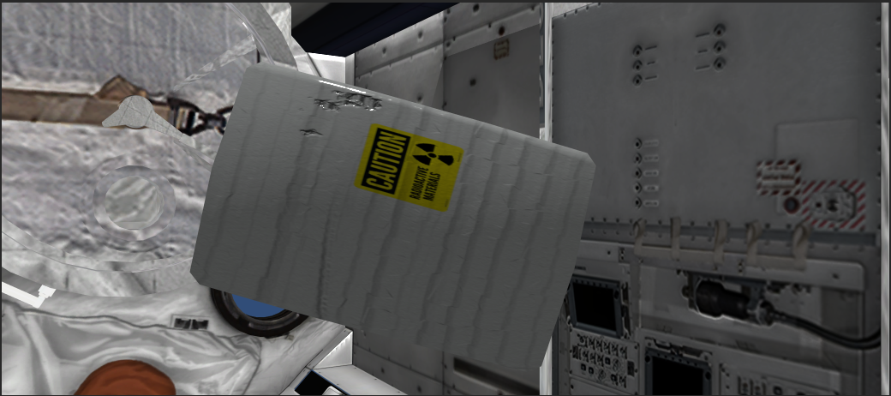
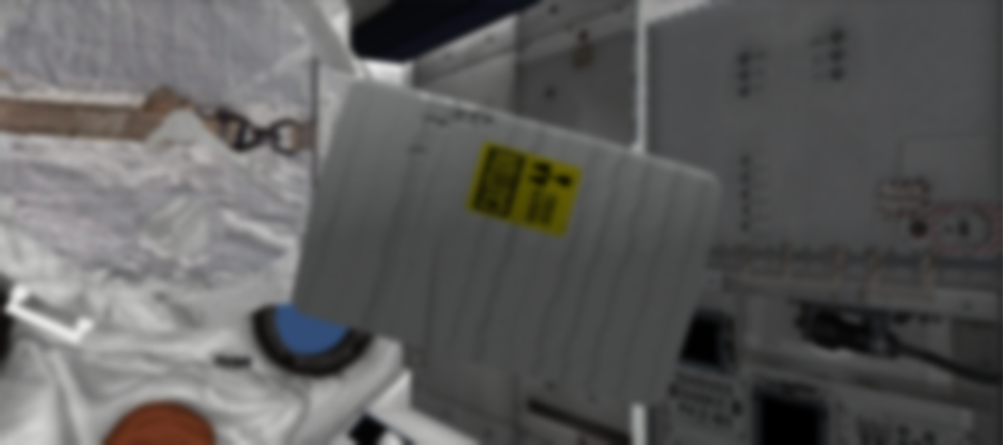
Image Noise
Left Camera: 0 noise
Right Camera: 15% Gaussian noise
Concerns: Impact on bounding boxes, semantic segmentation, boundaries (object detection)

Slide 17
Confidence
Due to noise and vehicle drift, the agent has many uncertainties.
A (full) prediction model is also insufficient (chaos).
Confidence: “How certain the agent is regarding its localization and state estimation, as well as objects, goals, and environmental states within the scenario.”
Baseline: Root-Mean-Square Error (RMSE) / Root-Mean-Square Deviation (RMSD)

Slide 18
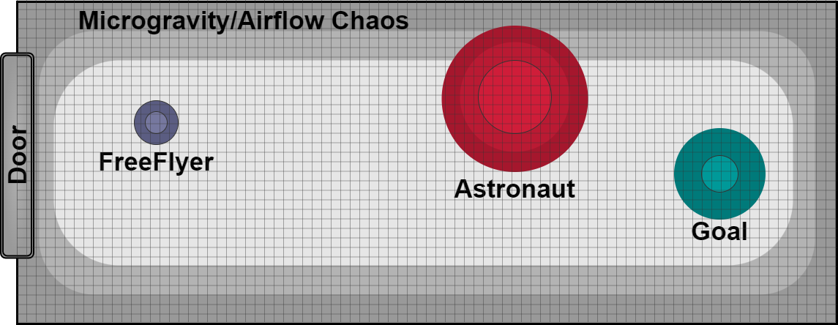
High-Level Chaos Map Example
C_{sys}
C_{obj}
C_{goal}
C_{env}

Slide 19
Objective Function (Abstraction)
Using adaptive sensor fusion:
Minimize: [Cost(k)]; k ⊃ {Energy, Temp_{sys}, C_{T}}
Subject to: [Available Sensors]
Subject to: [Task]
Subject to: [Policy]
with Constraint: [Confidence > Threshold] | d(task)
and [Distance] and [WCRT(T_{D})]

Slide 20
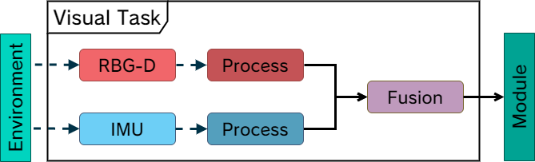

Slide 21
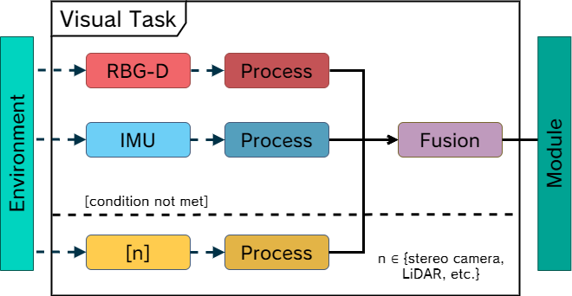

Slide 22
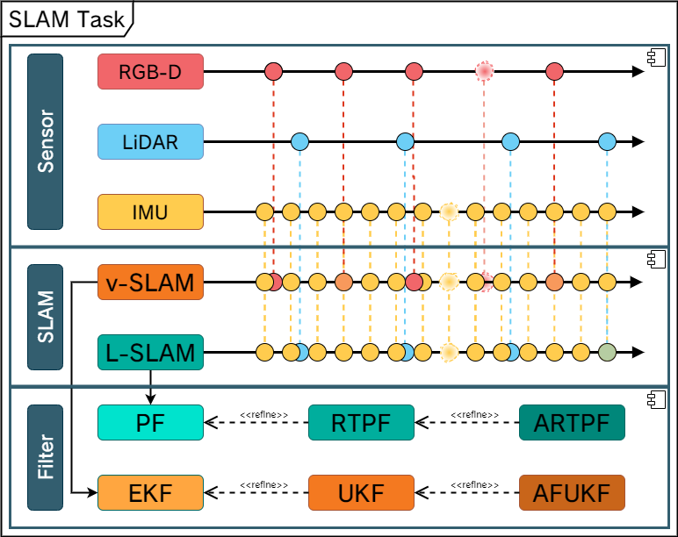

Slide 23
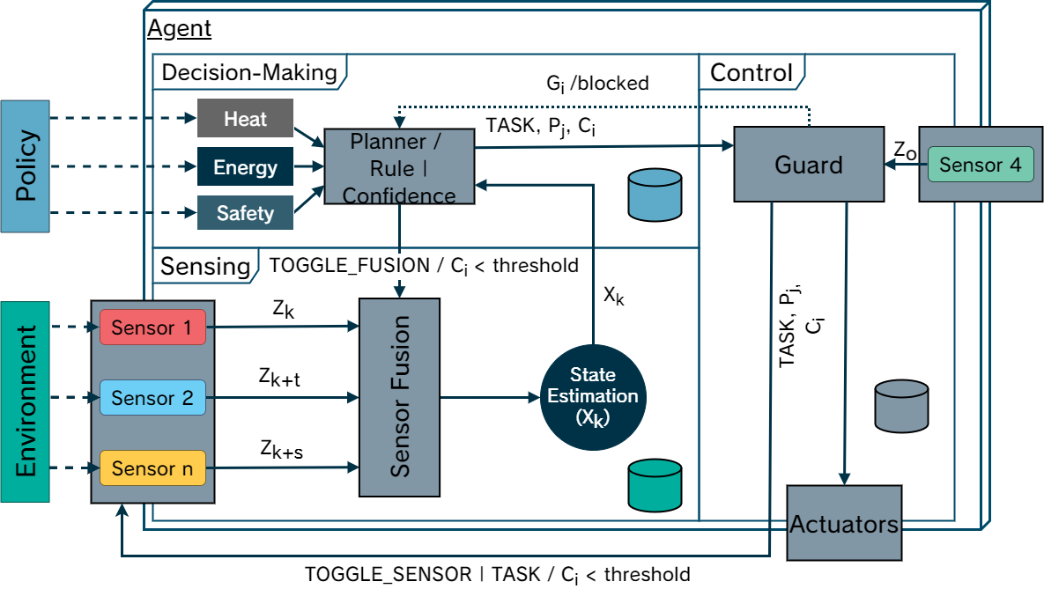

Slide 24
Implementation Details
Sensor synchronization
Rauch–Tung–Striebel Smoothing (RTS)
ROS sensor emulation:
IMU: Epson Seiko IMU
Camera: DUO MLX R2
ToF: ST vl53l1x
LiDAR: Slamtec RPLIDAR A3
Assumption: Heat proportional to Energy (Joule’s law)

Slide 25
Current Results
Simulation environment stable
Simulated sensors (IMUs, RGB-D cam, LiDAR, ToF)
Simulated noise, drift, chaos (python/Unity)
Created custom proprioceptive algorithm (IMU Mesh)
Decision trees for toggling
Initial trade-off results (heat vs mass vs confidence)

Slide 26
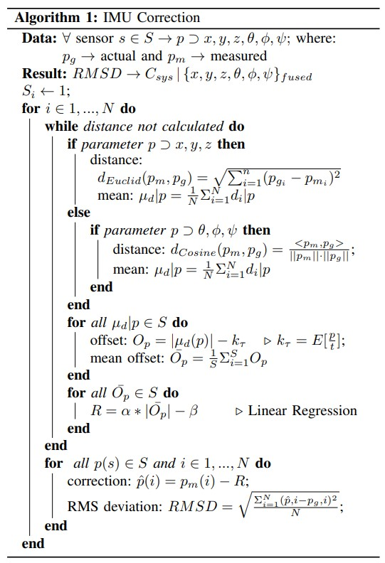
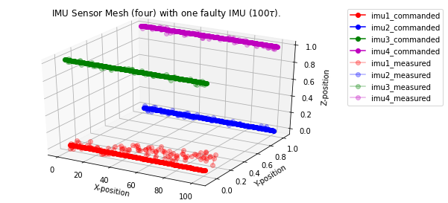
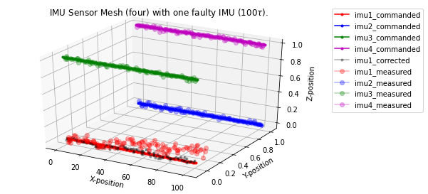
Measured
Corrected

Slide 27
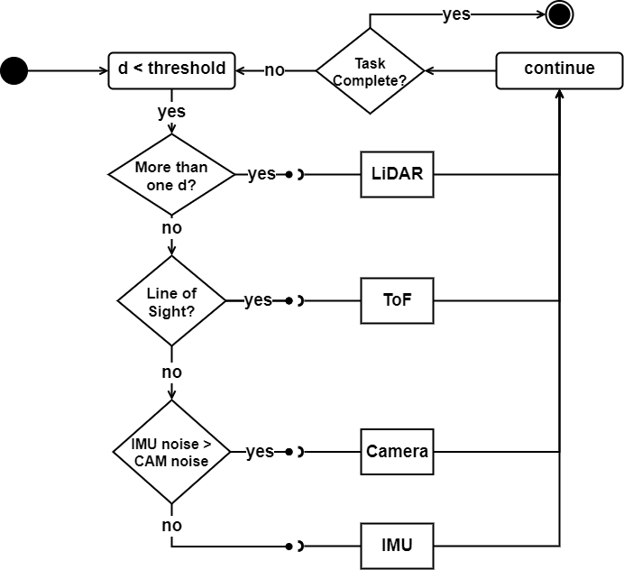
Decision Tree

Slide 28
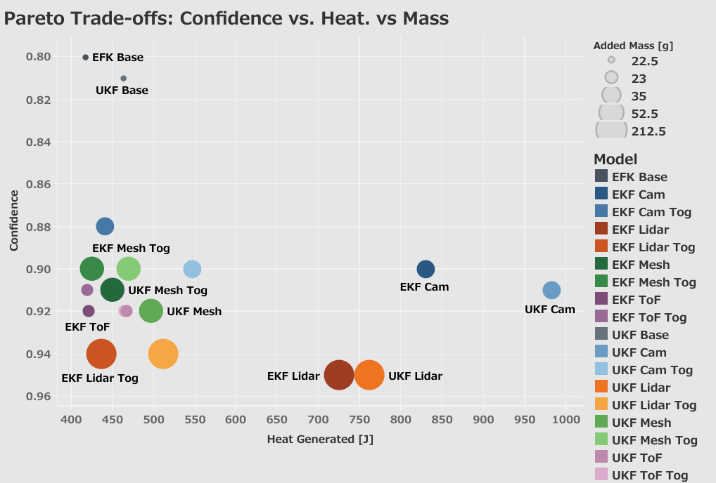

Slide 29
Future Work
Further Development
Additional sensors, sensor combinations
Onboard energy/heat calculations (currently post-analysis)
Particle Filter (PF, APF) and CNN (as filter)
may need edge computing
Variable/dynamic noise (currently static)
Formally define prognosis criteria (recalibration)
Reinforcement/Self-Learning
Allow agent to define its own decision tree
Define reward function for exploring and navigating chaos*

Slide 30

Questions?
Thank you very much!
Your feedback is valuable, so please comment anything.
cohara@g.ecc.u-tokyo.ac.jp

Slide 31
References
https://www.thespacereview.com/article/1579/1
https://www.motorbiscuit.com/international-space-station-good-investment/
https://iss.jaxa.jp/en/kiboexp/news/170714_int_ball_en.html
https://www.nasa.gov/mission_pages/station/research/news/iss-20-years-20-breakthroughs/
Maria G Bualat et al, Astrobee: A New Tool for ISS Operations, https://arc.aiaa.org/doi/pdf/10.2514/6.2018-2517
Riccardo Bonalli et al. (2019), GuSTO: Guaranteed Sequential Trajectory Optimization via Sequential Convex Programming, https://arxiv.org/abs/1903.00155
Alejandro Perez et al. (2012), LQR-RRT*: Optimal Sampling-Based Motion Planning with Automatically Derived Extension Heuristics, https://people.csail.mit.edu/tlp/pdf/2012/ICRA12_1657_FI.pdf
Damir Bojadžić et al. (2021), Non-Holonomic RRT & MPC: Path and Trajectory Planning for an Autonomous Cycle Rickshaw, https://arxiv.org/abs/2103.06141
Feng Lu et al. (2019), A multi-rate sensor fusion approach using information filters for estimating aero-engine performance degradation, https://www.sciencedirect.com/science/article/pii/S1000936119302146
Keenan Albee et al. (2019), Kinodynamic-RRT for Robotic Free-Flyers: Generating Feasible Trajectories for On-orbit Mobile Manipulation, http://brian.coltin.org/pub/albee2019kinodynamic.pdf
Dongliang Zheng, Panagiotis Tsiotras (2021), Accelerating Kinodynamic RRT* Through Dimensionality Reduction, https://arxiv.org/abs/2107.01259
Shinji Mitani et al. (2019), Int-Ball: Crew-supportive Autonomous Mobile Camera Robot on ISS / JEM, https://ieeexplore.ieee.org/document/8741689?ALU=LU1047759
Hiroki Kato et al., (2021), ROS and cFS System (RACS): Easing Space Robotic Development, https://ieeexplore.ieee.org/document/9438288
Hussein Sibai et al., (2019) Safe Reinforcement Learning for Control Systems: A Hybrid Systems Perspective and Case Study, http://publish.illinois.edu/husseinsibai/files/2019/10/Safe_RL_with_Continuous_Dynamics___HSCC2019-4.pdf
Rajesh Siraskar (2020), Reinforcement Learning for Control of Valves, https://arxiv.org/abs/2012.14668
Sajjad Safari et al (2014), Multirate multisensor data fusion for linear systems using Kalman filters and a neural network, https://academic.csuohio.edu/simond/pubs/Safari2014.pdf
Ko Chanho et al. (2020), Integrated Path Planning and Tracking Control of Autonomous Vehicle for Collision Avoidance based on Model Predictive Control and Potential Field, https://ieeexplore.ieee.org/document/9268369
Guchong Li et al., (2019), Asynchronous multi-rate multi-sensor fusion based on random finite set, https://www.sciencedirect.com/science/article/abs/pii/S0165168419300258
Wenqiang Pu et al., (2018), Optimal estimation of sensor biases for asynchronous multi-sensor data fusion, https://link.springer.com/article/10.1007/s10107-018-1304-2
Bingbing Gao et al., (2018), Multi-Sensor Optimal Data Fusion Based on the Adaptive Fading Unscented Kalman Filter, https://www.mdpi.com/1424-8220/18/2/488
Mengwei Sun et al., (2021), Adaptive Kernel Kalman Filter Multi-Sensor Fusion, https://ieeexplore.ieee.org/document/9627030
Joel Sansana et al., (2020), Sensor Fusion with Irregular Sampling and Varying Measurement Delays, https://pubs.acs.org/doi/10.1021/acs.iecr.9b05105
Jonathan Tremblay et al., (2018), Training Deep Networks with Synthetic Data: Bridging the Reality Gap by Domain Randomization, https://arxiv.org/abs/1804.06516

Slide 32
Backup Slides

Slide 33
Consideration:
This work may become a platform for simulating robots and sensor (fusion) combinations (industry partners)
This work may extend to multiple domains
(Rescue robots, UAVs, biomedical, autonomous driving)
Value: context-aware, adaptive, resilient, robust, dynamic, and non-system specific (agnostic)

Slide 34
Future Questions
Adaptive SLAM (https://www.mdpi.com/1424-8220/20/7/2068/pdf)
Fuse/Switch L-SLAM, vSLAM, VIO-SLAM
Multi-Agent Systems? (https://www.frontiersin.org/articles/10.3389/frobt.2021.618268/full)
Robot-to-Robot, static environment sensor (fixed cameras)
Edge Computing? (https://arxiv.org/abs/2112.13222)
Offload Sensor Fusion (or SLAM) tasks to external system
Toggle Actuators?
Turn on flashlight to normalize visual information (YOLO)
System Health Monitoring?
Utilizes other sensors to detect errors (calibration)

Slide 35
Benchmarking
NB: Dummy values
Sensors | Exec Time | Temp_{Sys} | Task Acc | SF
A | 20ms | +2 K/min | 40% | CNN
B | 10ms | +1 K/min | 30% | EKF
C | - | - | - | -
D | - | - | - | -
A+B | 28ms | +2.5 k/min | 65% | CNN + EFK
… | . | . | .
B+C+D | 50ms | +10 K/min | 99% | CNN + AFUKF
A+B+D+C | 60ms | +12 K/min | 99% | CNN + UKF + GP

Slide 36
Use Case: International Space Station
ISS cost per day: $7.5M [1]
Price per astronaut daily operation (average): $115,000 [2]
~10% of an astronaut’s time is taking pictures [3]
~$11,500/day /astronaut (~1,300,000円)
Personal Satellite Assistants (PSA; Astrobee, INT-Ball) meant to assist astronaut (documentation) tasks
Can also have gripper/manipulator to grab objects
Astronauts can spend more time on critical research
but…PSAs do not perform very well overall…

Slide 37
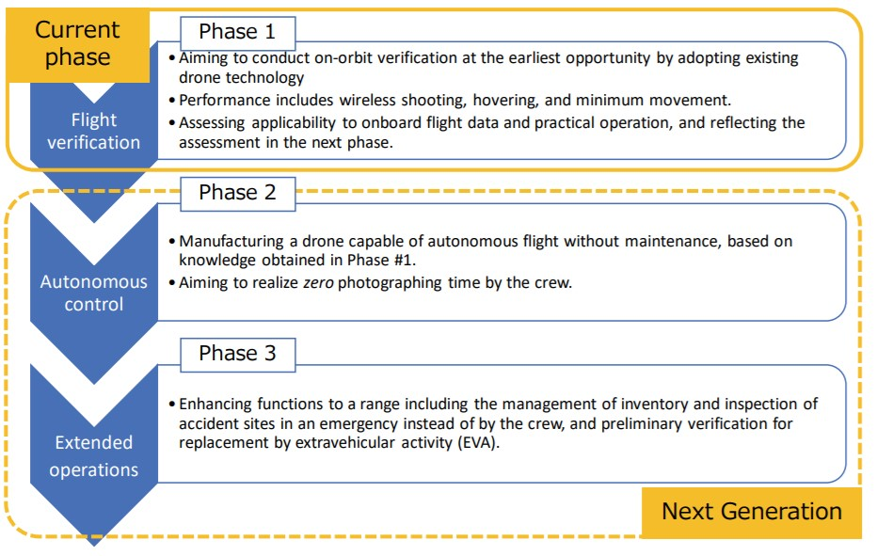
JAXA Timeline for INT-Ball
Source: JAXA [12]

Slide 38
Hardware Challenges
Limited computation power
External computing? (JAXA/NASA did not try!)
Time-driven, event-driven sampling
Sensors have asynchronous update rates -> need adaptive sensor fusion
Heat generation
No convection on ISS (heat stays in one place)
Limited propulsion/thrust
All agents use small “blower” fans
Sensor latency
NASA: IMU latency is reportedly bad, IMU bias vs ground truth

Slide 39
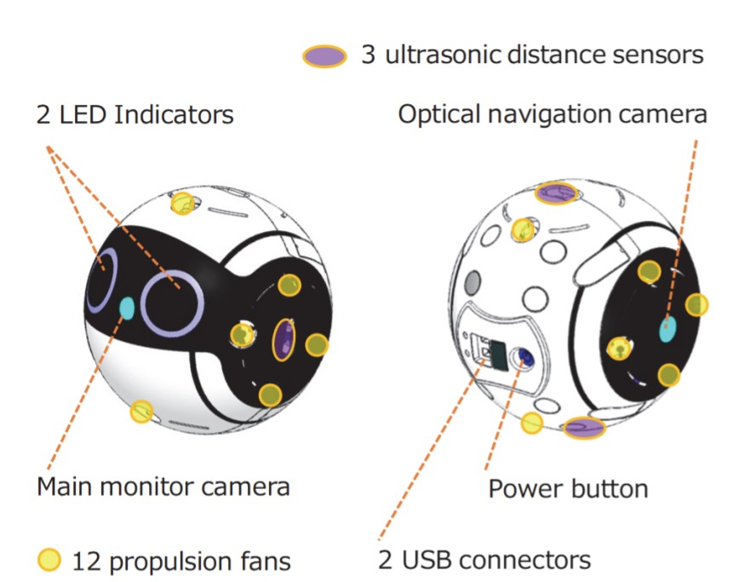
INT-Ball Sensors Data

Slide 40
Research Background
International Space Station PSAs
Astrobee & INT-Ball2 -> Astrobee, INT-Ball3, avatarin
“Adaptive Sensor Fusion” (センサーフュージョン)
Main Focus: “Develop adaptive sensor fusion algorithm for sensor switching meeting utilization and real-time deadlines with high accuracy.” AFUKF [], S-GCI fusion algorithm [18]
Sub: Information filter for decision planning (Kalman Filter - カルマンフィルター)
Health (anomaly) w/ multirate-multisensory data fusion [9], with deep learning [16]
Sub: Real-time Learning Systems (RL, LDS, GA) (強化学習)
Safe Reinforcement Learning for Control Systems [14], RL for control of actuators DDPG [15]
Integrated path planning and control systems [17]
Non-Holonomic RRT & MPC [8], NASA: Kinodynamic-RRT [10,11]
Integrated mapping (vSLAM) (Yairi-sensei; Minoda-san)
Simulation Environments (Verification & Validation)
ISS with ROS (Astrobee)
ISS in Unity -> Synthetic Data Generation and Algorithm Validation
Testing: Guest Science Access on ISS (Astrobee), JAXA SP-ROS (https://github.com/jaxa/roscfe)
Extend to avatarin, INT-Ball3, Astrobee

Slide 41
Robotic Challenges
PSAs have many sensors, but not all sensors are used
JAXA/NASA both said we can access the sensor since they’re published
Time-driven, event-driven sampling
Sensors have asynchronous update rates -> need adaptive sensor fusion
Simultaneous Mapping and Localization (SLAM)
Avoid Markers (QR code)
Map updating method (online vs offline); update rate (e.g., NASA ~6months)
Control Systems
JAXA: simple PID, NASA: MPC (WIP)
Path Planning
Based on sensor fusion and SLAM; (NASA: GuSTO [6])
Motion/Trajectory Planning
NASA: LQR-RRT* [7]
Autonomy
Obstacle (person) avoidance, decision planning, task completion accuracy, anomaly

Slide 42
Simulation Environments
Simulation Environments (Verification & Validation)
ISS with ROS (Astrobee)
Testing: Guest Science Access on ISS (Astrobee), JAXA SP-ROS [14] (https://github.com/jaxa/roscfe)
ISS in Unity -> Synthetic Data Generation and Algorithm Validation [23]
Extend to avatarin, INT-Ball3, Astrobee

Slide 43
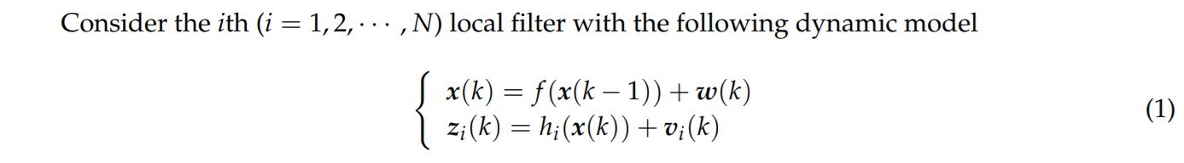
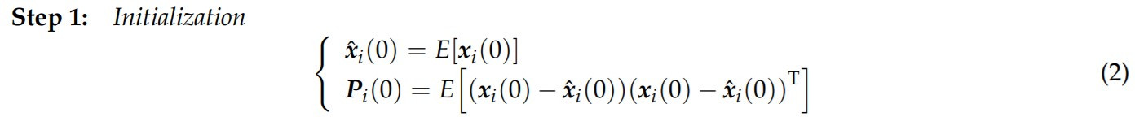
Unscented Kalman Filter

Slide 44
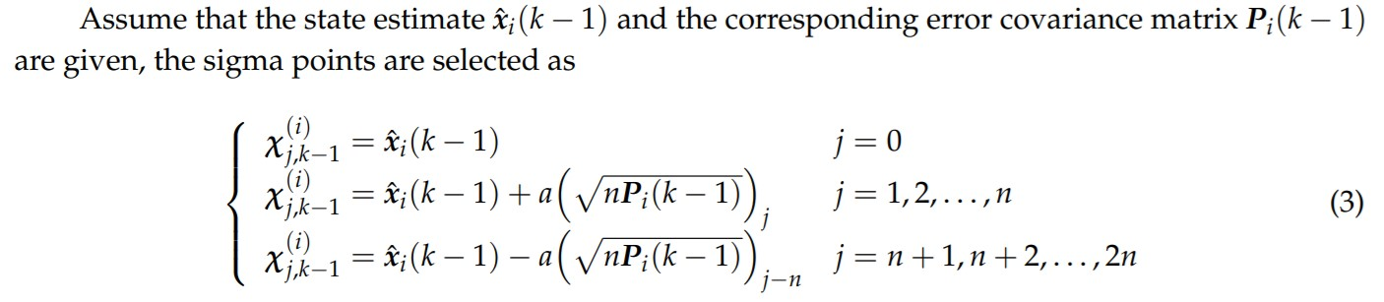
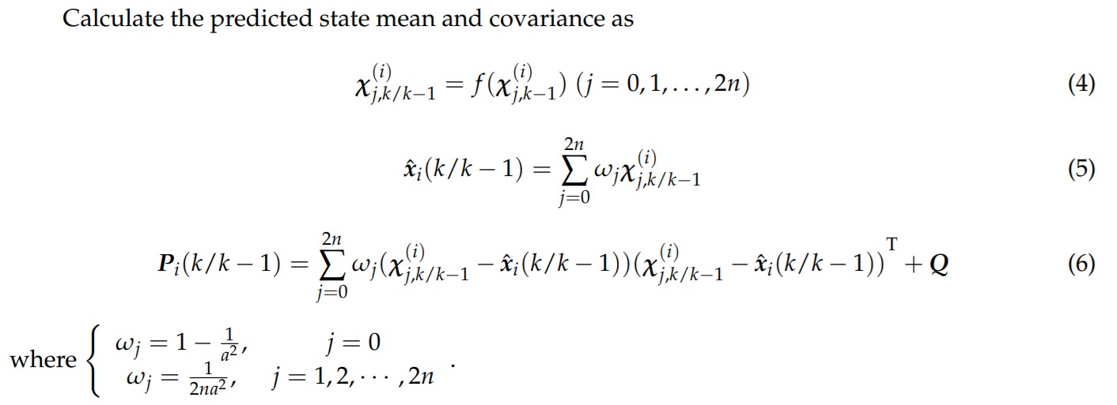

Slide 45
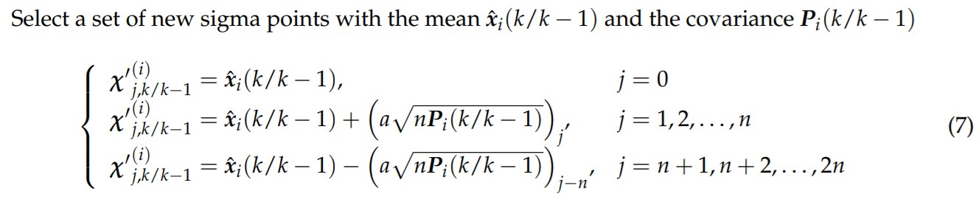
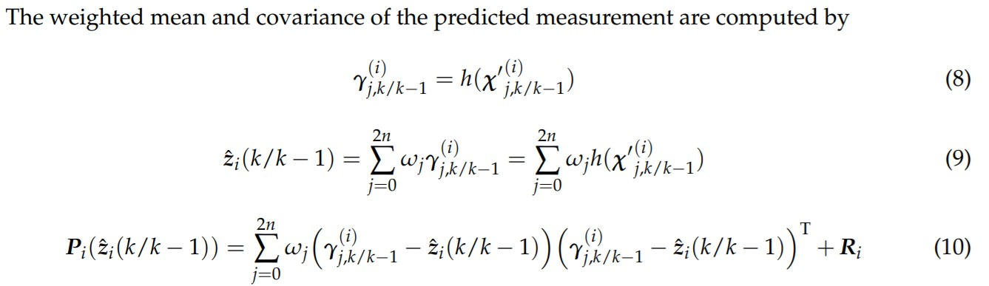

Slide 46
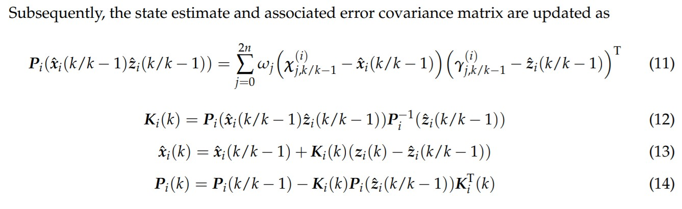

Slide 47
Astrobee Specifications
Mass: 10kg (with 2/4 batteries installed)
Maximum Velocity: 0.5 m/s
Maximum Thrust (X-axis): 0.6 N
Minimum moving distance: 0.05 m
Minimum rotating angle: 7.5 degrees

